Slide 1


Welcome to the
Title I Annual Meeting for Parents & Families
2024-2025
Tuckaseegee Elementary School
LaTresha Wilson, Principal
Germeka Ogundapo, Title 1 Compliance Coordinator
August 22, 2024

Slide 2
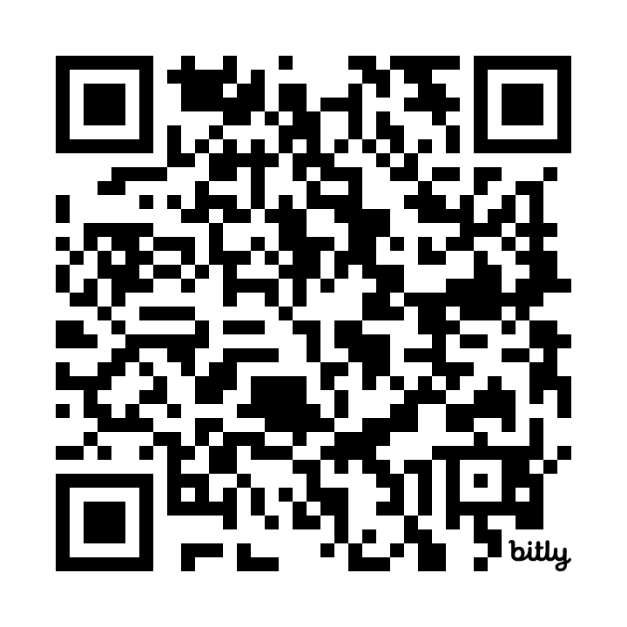
Meeting Attendance

Slide 3
Why are we here?
The Elementary and Secondary Education Act (ESEA), as amended by the Every Student Succeeds Act (ESSA) of 2015, requires that each Title I School hold an Annual Meeting for parents/families/community members for the purpose of:
Informing you of your school’s participation in Title I services
Explaining the requirements of Title I, Part A
Explaining your rights as parents to be engaged

Slide 4
Meeting Overview
What is a Title I school and what it means to be a Title I school
Required Set-Aside for parent and family engagement
The CMS Parent and Family Engagement Policy
How the annual evaluation of the CMS Parent and Family Engagement Policy is conducted
School Parent and Family Engagement Policy
School Improvement Plan (SIP) in NCStar
School-Parent Compact
How to request the qualifications of my child’s teacher(s)
How parents will be notified if my child is taught by a teacher who is not deemed to be qualified by teacher licensing standards in the North Carolina ESSA Accountability Plan
Notes:
Discuss:
How you want them to walk away from the meeting with 10 key questions answered about Title I and Parental Involvement. (The 10 questions continue onto the next slide.)

Slide 5
What is a Title I school?
Title I is the largest federally funded educational program. A Title I school is a school receiving federal funds for students. The basic principle of Title I is that schools with large concentrations of students with economic needs receive supplemental funds to meet students’ educational goals.

Slide 6
What does it mean to be a
Title I School?
Being a Title I school means receiving federal funding (Title I dollars) to supplement the school’s existing programs. These dollars are used for the following:
  Identifying students experiencing academic difficulties and providing timely assistance to help students meet the state’s challenging content standards.
  Purchasing supplemental staff/programs/materials/supplies
  Conducting parent and family engagement meetings/trainings/activities
  Recruiting/Hiring/Retaining Highly-Qualified Teachers
Being a Title I school also means encouraging ongoing parent and family engagement and advocating for parents’ rights
Notes:
Discuss:
How being in a Title I school means more money to help students who are struggling in school
- Give examples of how Title I monies will be used to assist students at the school.
Give examples of how Title I monies will be used to assist parents.
(Consider giving demonstrations of programs used or allow parents to visit work stations and experience what the student experiences.)
- Explain that a big part of Title I means parents’ rights, by law, to be involved in decisions made at the school level and at the LEA level. (This will be discussed throughout the meeting.)
Important: Parents should leave the meeting being able to answer the following question: What does it mean to be a Title I school? (They should be able to answer the question and give a couple of examples of how Title I funds are being used at their school.)

Slide 7
How are Title I funds used in our school?
Instructional Leaders
Behavior Modification Technician (BMT)
Parent Involvement Activities
Professional Development for staff
Substitutes for staff professional development
Supplies and materials

Slide 8
What is the 1% set-aside and how are parents involved?
Any Local Education Agency (LEA) or school district with a Title I Allocation exceeding $500,000 is required by law to set aside 1% of the Title I allocation for parent and family engagement.
Of that 1%, 10% may be reserved at the LEA/district level for system-wide initiatives related to parent and family engagement. The remaining 90% must be allocated to all Title I schools in the district. In CMS, each Title I school receives its portion of the 90% to implement school-level parent and family engagement activities and events
Title I parents have the right to provide input into decisions regarding how this money is spent. This process is completed through the School Improvement Team (SIT)
Notes:
Discuss:
- What the LEA’s Title I allocation is.
- What the 1% amount is.
How much of the 1% (Up to 5%) was reserved, off the top, at the LEA for System-wide initiatives. Give examples of the system-wide initiatives.
- Give parents the amount (the 95% amount) that is shared by all the Title I schools in the school system.
Give the amount your school received for parental involvement (Your school’s portion of the 95% of the 1%).
How there is a committee (LEA Advisory Committee) that makes decisions on funds reserved and on funds allocated to the Title I schools.
That Title I parents have the right, by law, to be involved in decisions on how the 1% set-aside is spent (both at the LEA and at their school)
- The timeline for the LEA Advisory Committee’s work. How parents will be reminded and informed of the committee’s work so they may give timely input.
- Clearly state the process that is in place for all Title I parents to have the opportunity for input on how the 1% funds are spent.
Important: Parents should leave the meeting being able to answer the following question: What is the 1% set-aside, and how can you be involved in decisions regarding how the money is used?
(Parents should be able to discuss the process that is in place for their involvement in decisions regarding the 1% set-aside, both for system-wide initiatives and school-level activities.)

Slide 9
Parent and Family
Engagement Allocation
How we are spending our Title I funds:
* Funding staff positions
* Classroom Materials and Supplies
* Incentives for students

Slide 10
What is the CMS
Parent and Family Engagement Policy?
This policy addresses how the district or LEA will implement the parent and family engagement requirements of the Every Student Succeeds Act (ESSA). It includes the following:
  The district’s expectations for parents
  How CMS will engage parents in decision-making
  How the district will work to build the schools’ and parents’ capacities in the implementation of effective parent and family engagement activities to improve student academic achievement
Parents and families in Title I schools have the right to be engaged in the review/evaluation of this annual policy
Notes:
Distribute the LEA Parental Involvement Plan.
Discuss:
Key components of the plan.
- That Title I parents have the right, by law, to be involved in the development of the LEA Parental Involvement Plan
- What collaborative committee(s) develops the plan.
- The process and timeline for the committee’s work. How parents will be reminded and informed of the committee’s work so they may give timely input.
- Clearly state the process that is in place for all Title I parents to have the opportunity for input on the LEA Parental Involvement Plan. Discuss any surveys, focus groups, parent representatives, etc. that are a part of that input.
Important: Parents should leave the meeting being able to answer the following question: What is the LEA Parental Involvement Plan, and how can you be involved in the development of the plan? (Parents should be able to discuss the process that is in place for their involvement in the development of the LEA Parental Involvement Plan.)

Slide 11
What is the School Improvement Plan/NCStar Plan?
The School Improvement Plan (SIP) is created in an online platform called NCStar and includes:
  A Comprehensive Needs Assessment
  Goals and Strategies to Address Academic Needs of Students
  Professional Development Needs
  Coordination of Resources and Comprehensive Budget
  The School’s Parent and Family Engagement Goals
Parents of students at Title I schools have the right to be engaged in the development of this plan
Access the SIP on our website:
  User Name: guests7107
  Password: guests7107
SIP Meeting September 25 at 5pm on Microsoft Teams.
Notes:
- Have copies of the complete SIP available for parents to refer to during this discussion (The SIP could very well still be in draft form at the time of this meeting, which presents an excellent opportunity for parent input while the SIP is under development.) Note: The school’s Parental Involvement Plan (which is the parental section of the SIP) will be addressed on the next slide.
- Consider having SIP committee representatives, particularly parent representatives, to share about the work of the committee during these two slides.
Discuss:
Key components of the plan. This is an excellent time to share the school’s academic strengths & weaknesses with parents & how we will need to all work together as partners to meet certain goals, both for the school and for each individual child.
- That Title I parents have the right, by law, to be involved in the development of the SIP.
The process and timeline for the SIP committee’s work and how parents can give input.
Introduce parent representatives of the committee
Clearly state the process that is in place for all Title I parents to have the opportunity for input on the SIP.
Where parents can find a complete copy of the SIP at any time during the year.
Important: Parents should leave the meeting being able to answer the following question: What is the SIP, and how can you be involved in its development? (Parents should be able to discuss the process that is in place for their involvement in the development of the SIP.)

Slide 12
What is included in the School’s Parent and Family Engagement Policy?
This policy addresses how the school will implement the parent and family engagement requirements of the Every Student Succeeds Act (ESSA). Components include the following:
  How parents can be engaged in decision-making and activities
  How parent and family engagement funds are being used
  How information and training will be provided to parents
  How the school will build capacity in parents and staff for strong parent and family engagement
Parents of students at Title I schools have the right to be engaged in the development of the school’s Parent and Family Engagement Policy
Notes:
Distribute the school’s Parental Involvement Plan (the Parental Involvement Section of the SIP).
Discuss:
- That the school’s parental involvement plan is a part of the CIP, designed to work with the other parts in increasing student achievement.
key components. Emphasize the Building Capacity component and discuss all of the opportunities that will be available for parents this year. Discuss how you will be implementing all of the “shalls,” as these are required by law to be implemented.
- That Title I parents have the right, by law, to be involved in the development of the school’s Parental Involvement Plan
The process and timeline for the plan’s development and how parents can give input.
Introduce parent representatives of appropriate committees
Clearly state the process that is in place for all Title I parents to have the opportunity for input on the plan.
Important: Parents should leave the meeting being able to answer the following question: Did you receive a copy of your school’s Parental Involvement Plan, and do you know how you can be involved in its development? (Parents should be able to discuss the process that is in place for their involvement in the development of their school’s Parental Involvement Plan.)

Slide 13
What is the
School Compact?
The compact is a commitment from the school, the parent/family, and the student, to share in the responsibility for improved academic achievement
Parents and families of students in Title I schools have the right to be involved in the revision/review of the School Compact
Notes:
Distribute the School-Parent Compact.
Discuss:
- The 3 components of the compact in detail. This is a great opportunity to continue the discussion on how we need to work as partners to address the school’s goals, building upon the earlier discussion about the CIP and the school’s goals.
- That Title I parents have the right, by law, to be involved in the development/revision of the School-Parent Compact
The timeline for the compact’s development/review/revision.
Clearly state the process that is in place for all Title I parents to have the opportunity for input on the compact.
Important: Parents should leave the meeting being able to answer the following question: What is the School-Parent Compact, and do you know how you can be involved in developing or revising the compact? (Parents should be able to discuss the process that is in place for their involvement in the development/revision of the School-Parent Compact.)

Slide 14
Who are the parent leaders at my school?
Jessica Willis, PTA President
Sharayia Bowens, PTA Treasurer
Tracy Campbell, Secretary
Tuckaseegeepta2425@gmail.com
Facebook: Tuckaseegee PTA
School’s Title I Compliance Contact:
Germeka Ogundapo, Dean of Students

Slide 15
How can I volunteer to assist my student with school needs?
Join or attend the School Improvement Team/School Leadership Team
Volunteer to contact other parents/families regarding important school information:
  Ex. – 100% Compact completion
  Events occurring at your child’s school
  Opportunities to participate in/support school activities
Please call or email Germeda Ogundapo if you have any questions or concerns
  Germeda Ogundapo - Dean of Students
  germekam.ogundapo@cms.k12.nc.us

Slide 16
How do I request the qualifications of my child’s teachers?
Title I parents and families have the right to request the qualifications of their child’s teachers
How are you notified of this right and what is the process for making a request?
  You can request it from Ms. Ogundapo
  Request should be completed within 30 days
Notes:
Discuss:
Explain that as Title I parents, they have the right, by law, to request the qualifications of their child’s teachers.
Explain the process/simple procedure for parents to make this request
Have extra copies of the request form available for all parents in attendance.
Give them a contact person in case they have any questions.
Important: Parents should leave the meeting being able to answer the following question: Do you know the process for requesting the qualifications of your child’s teachers? (Parents should be able to discuss the process that is in place for requesting teacher qualifications.)

Slide 17
How will I be notified if my child is taught by a teacher who is not Highly-Qualified?
Being Highly Qualified in NC means you have successfully passed the licensure exams required or received alternate licensure in a way set out by NC law.
Parents and families are notified if teachers do not meet ESSA’s requirements for Highly-Qualified
Parents may request information on teacher qualifications in writing
Notes:
Discuss:
Tell parents the number of teachers in the school who are currently Highly Qualified and the number not Highly Qualified.
Explain the NCLB requirement that Title I parents must be notified if their child has been assigned to or taught for four or more consecutive weeks by a teacher who is not Highly Qualified.
Clearly state the process that is in place for notifying parents.
Important: Parents should leave the meeting being able to answer the following question: How will you be notified if your child’s teacher is not Highly Qualified? (Parents should be able to discuss the process that is in place for notifying parents if there child is assigned to or taught for four or more consecutive weeks by a teacher who is not Highly Qualified.)

Slide 18
North Carolina Standard Course of Study
The full North Carolina Standard Course of Study (NCSCOS) can be viewed using the link below:
http://www.dpi.state.nc.us/curriculum/
For more information about the NCSCOS and professional development at your school site, please reach out to _______________ .

Slide 19
Some Schools Have an Additional Designation
NCDPI will notify schools as to whether they have a special designation of TSI or CSI in November, 2022. Skip this slide and the next two until notification from NCDPI.
The Every School Succeeds Act (ESSA) requires each state to have a plan to measure student achievement annually
The plan outlines how each state is being held accountable
Title I schools can receive an additional designation based upon state End-of-Grade or End-of-Course assessments
Link to the North Carolina State Plan under ESSA:
http://www.ncpublicschools.org/succeeds/

Slide 20
Additional School Designations
Targeted Support and Improvement (TSI)
Comprehensive Support and Improvement (CSI)
Schools with these designations remain in this status for 3 years
Our school (is) designated as a __________
school in the subgroup of _____.

Slide 21
Targeted Support and Improvement
North Carolina's Every Student Succeeds Act (ESSA) State Plan identifies schools for targeted support and improvement when schools have student subgroups that are underperforming
Our school has this designation
We have a comprehensive plan of professional development for staff

Slide 22
Proud Points
Tuckaseegee Elementary school consistently builds a culture of caring, support, and focus on academic growth.
Tuckaseegee Elementary has strong community partnerships with community and faith-based organizations who provide support for our students and staff!

Slide 23
Thank you for being here!
Questions?
Email Ms. Ogundapo germekam.ogundapo@cms.k12.nc.us or call her at school 980-343-6055
Revised August 2019

Slide 24
Welcome to Tuckaseegee PTA
2024-2025

Slide 25
PTA Board
Jessica Willis, PTA President
Sharayia Bowens, PTA Treasurer
Tracy Campbell, Secretary
School Liaison
Maseen Crumpler, Magnet Coordinator
Germeka Ogundapo, Dean of Students

Slide 26
PTA Budget
2023-2024 School Year
Beginning Balance
$2,315.96
Ending Balance
$22,127.04

Slide 27
2024-2025 School Budget Request
Student Incentives $3,000
Staff Incentives $5,000
School Aesthetics $1,000
Principal Discretion $750
Parent Engagement $250
Total $10,000

Slide 28
PTA Events
Sept 3-6 Double Good Popcorn
Oct Bookfair (Fall)
Nov Bingo Night
Feb Candy Grahams
Feb Sneaker Ball
May Field Day

Slide 29

Fundraisers
Tuckaseegee Shirts
School Store Program
www.schoolstore.com

Slide 30
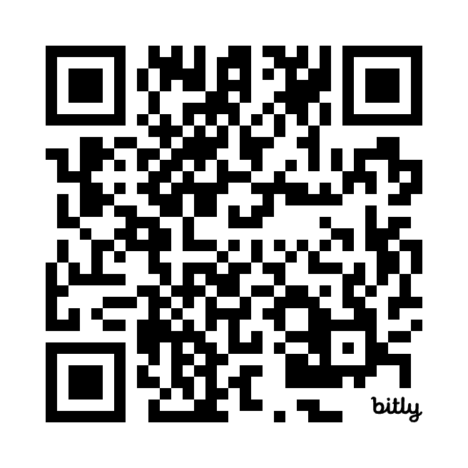
PTA Interest

